Slide 1


Neural Networks Project
“COVID-ResNet: A Deep Learning Framework for
Screening of COVID19 from Radiographs”
Leandro Maglianella - 1792507

Slide 2
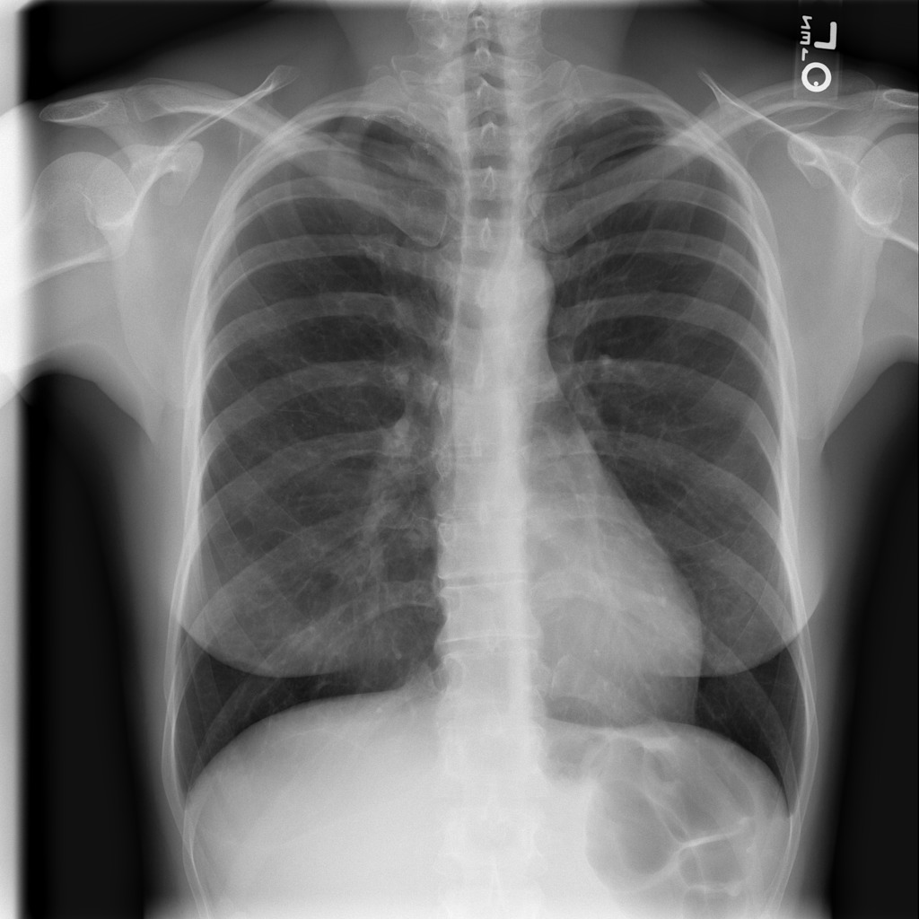
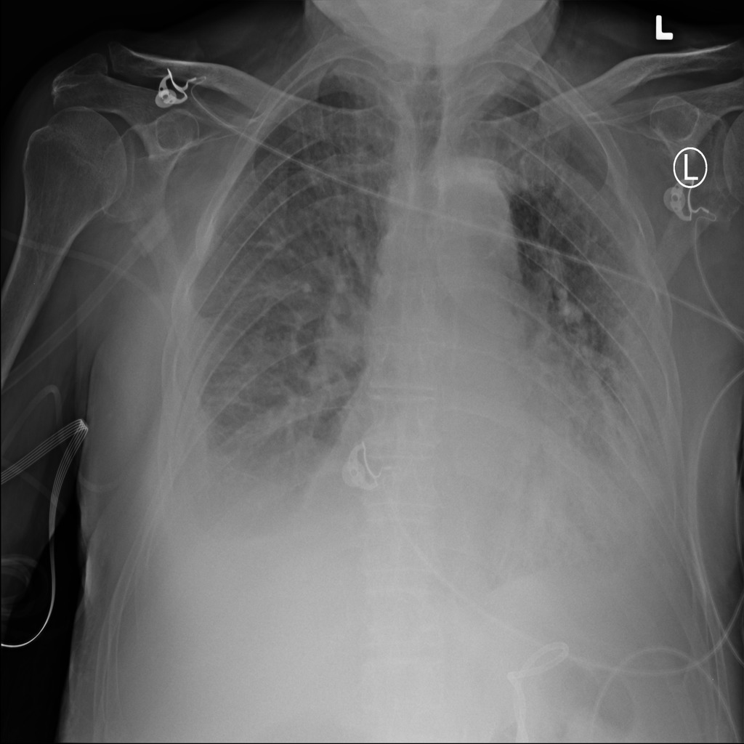
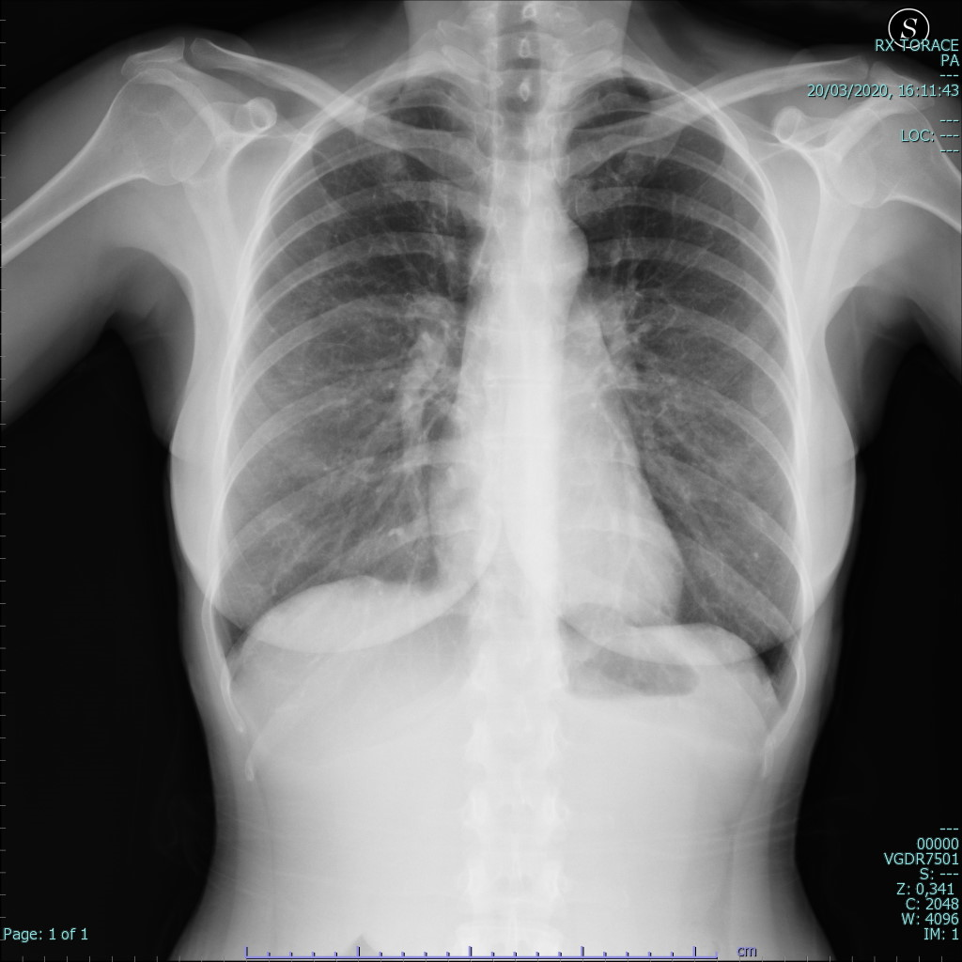
Task Description
A supervised multiclass classification of radiography images.
Normal
Pneumonia
COVID-19
Neural Networks Project
Pagina <number>

Slide 3
Data Generation and Processing
Neural Networks Project
Pagina <number>

Slide 4
COVIDx V7A Dataset Generation
It is constructed by samples coming from five main open-source X-ray chest radiography datasets hosted online.
Type | Training images | Test images | Total images
Normal | 7966 | 885 | 8851
Pneumonia | 5475 | 594 | 6069
COVID-19 | 1645 | 67 | 1712
Total | 15086 | 1546 | 16632
Type | Training patients | Test patients | Total patients
Normal | 7966 | 885 | 8851
Pneumonia | 5451 | 591 | 6042
COVID-19 | 1483 | 46 | 1529
Total | 14900 | 1522 | 16422
Neural Networks Project
Pagina <number>

Slide 5
Data Pre-processing
Images processed to produce .npy files.
Procedure repeated three times to get all the data needed for the progressive resizing method.
File | Description | Dimensions
x_train_128.npy | 15086×128×128×3 training array | 2.76 GB
x_train_224.npy | 15086×224×224×3 training array | 8.45 GB
x_train_229.npy | 15086×229×229×3 training array | 8.84 GB
y_train.npy | 15086×1 training labels’ array | 60 KB
x_test_128.npy | 1546×128×128×3 test array | 289 MB
x_test_224.npy | 1546×224×224×3 test array | 887 MB
x_test_229.npy | 1546×229×229×3 test array | 927 MB
y_test.npy | 1546×1 test labels’ array | 7 KB
Total |  | 22.1 GB
Neural Networks Project
Pagina <number>

Slide 6
Network Architecture
Neural Networks Project
Pagina <number>

Slide 7
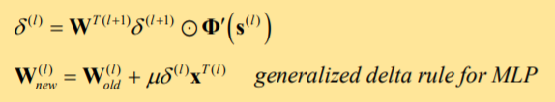

Vanishing Gradient Effect
Accuracy degradation in deep neural networks: too many layers saturate or decrease the accuracy value.
During training, in the error’s backpropagation phase, each of the neural network's weights is given a new value that is proportional to the partial derivative of the error function.
Sometimes, especially for the network’s initial layers, it happens that the gradient is extremely small, so much that the update significance vanishes and the weights are prevented from changing its value.
Neural Networks Project
Pagina <number>

Slide 8
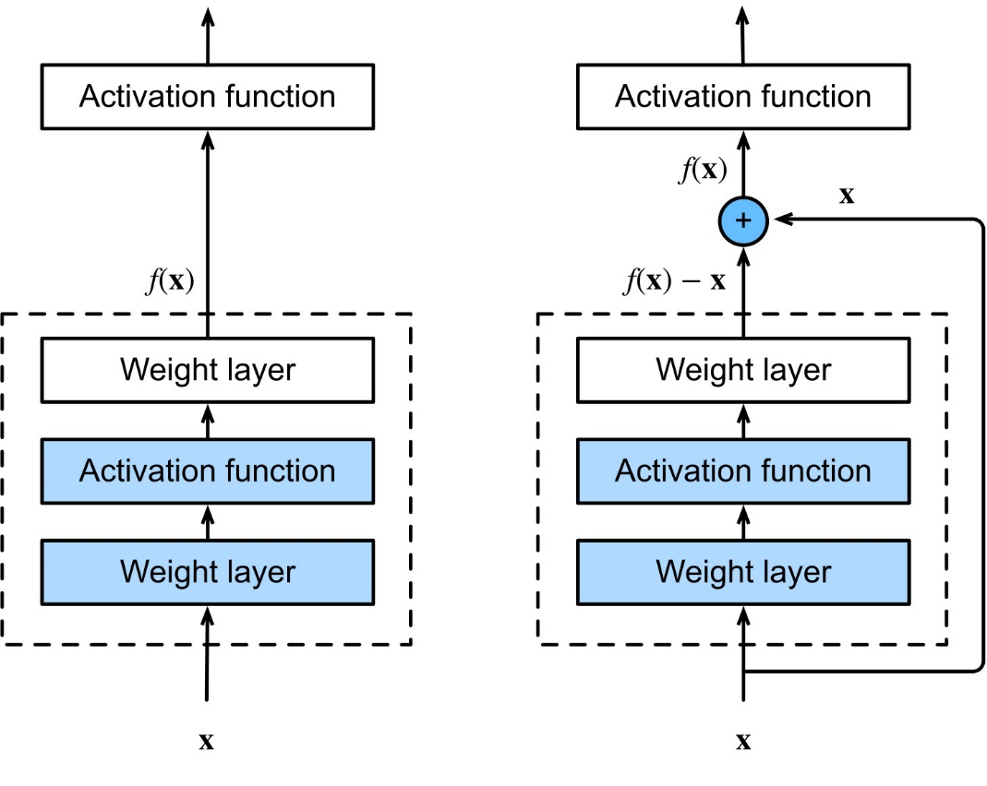
Residual Neural Networks
ImageNet Large Scale Visual Recognition Challenge (ILSVRC) 2015
Skip connections are a shortcut path for gradient to flow through, allowing the model to learn an identity function which ensures that the higher layer will perform at least as good as the lower layer.
Deep neural network architectures that are reliable and easier to train to high performance using a lower number of training parameters and taking less training time.
Neural Networks Project
Pagina <number>

Slide 9
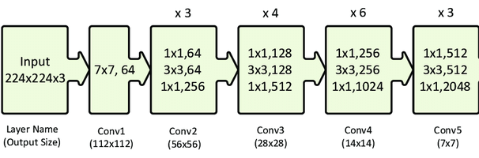
Network Architecture: body
The architecture of ResNet50’s body is composed by 4 stages:
Neural Networks Project
Pagina <number>

Slide 10
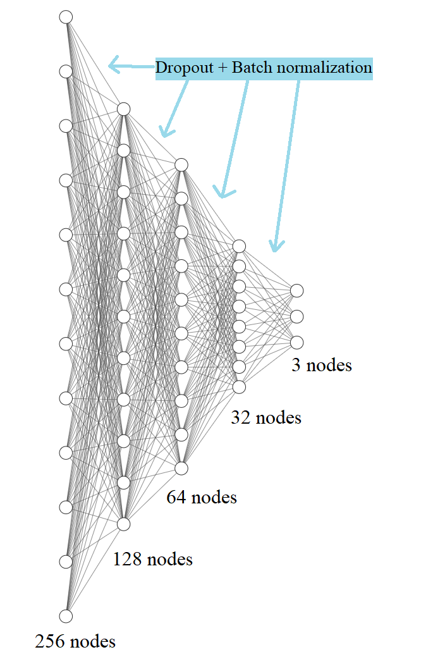
Network Architecture: head
For transfer learning, the head of the ResNet50 model is replaced with another head containing a sequence of drop out, batch normalization and fully connected layers.
Neural Networks Project
Pagina <number>

Slide 11
Training
Neural Networks Project
Pagina <number>

Slide 12
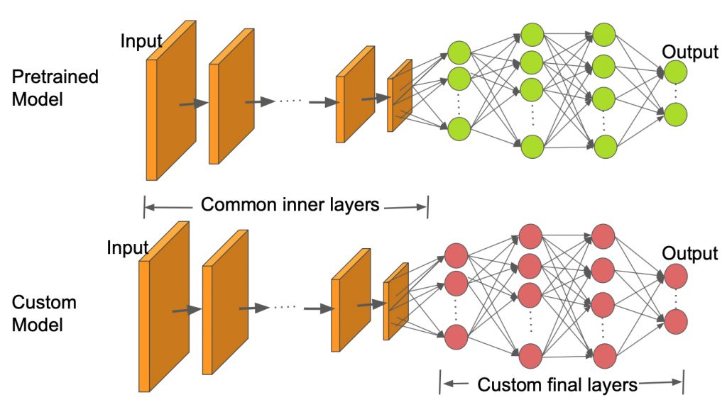
Transfer Learning
A model pre-trained on a large and general enough dataset (ImageNet in my case) will qualifies as a generic model of visual world.
Fine-Tuning and Progressive Resizing
Neural Networks Project
Pagina <number>

Slide 13
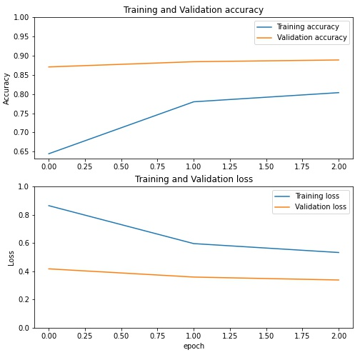
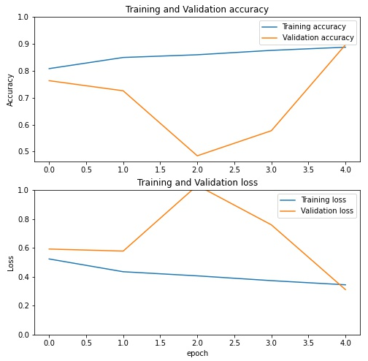
Training: stage 1
Input: 128×128×3. This stage is formed by 2 steps:
  Only the newly added head is trained with a learning rate of 1e-3 for 3 epochs, while preserving the ImageNet weights for the rest of the body which is freezed.
  The body is unfreezed and the whole network is fine-tuned (both the body and the head of the model) with a learning rate of 1e-3 for 5 epochs.
Neural Networks Project
Pagina <number>

Slide 14
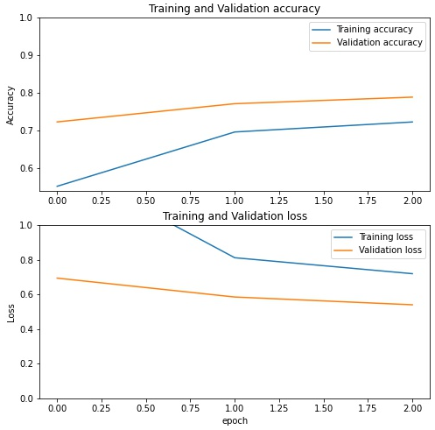
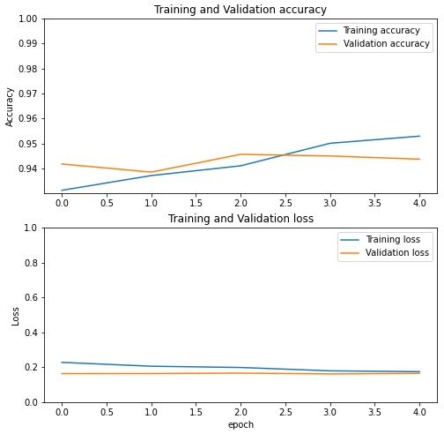
Training: stage 2
Input: 224×224×3. This stage is formed by 2 steps:
  Only the newly added head is trained with a learning rate of 1e-4 for 3 epochs, while preserving the weights for the rest of the body which is freezed.
  The body is unfreezed and the whole network is fine-tuned (both the body and the head of the model) with a learning rate of 1e-4 for 5 epochs.
Neural Networks Project
Pagina <number>

Slide 15
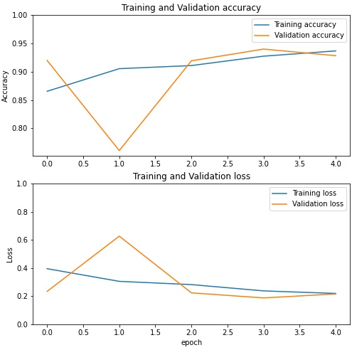
Training: stage 3
Input: 229×229×3. This stage is formed by only one step:
  The whole network is fine-tuned (both the body and the head of the model) with a learning rate of 1e-5 for 5 epochs.
Neural Networks Project
Pagina <number>

Slide 16
Results
Neural Networks Project
Pagina <number>

Slide 17
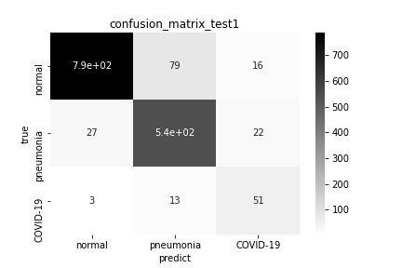
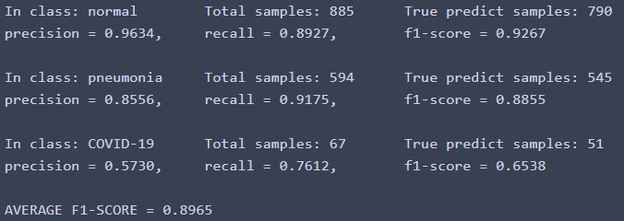

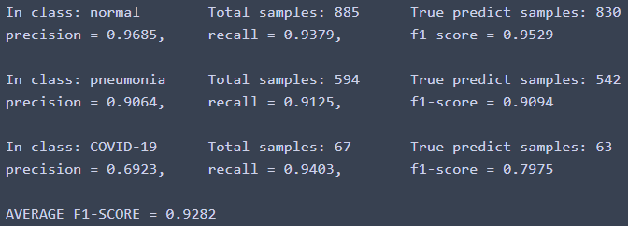
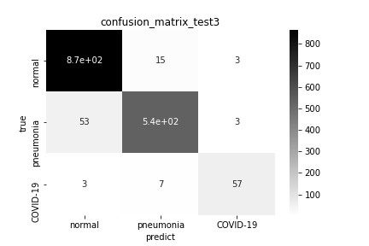
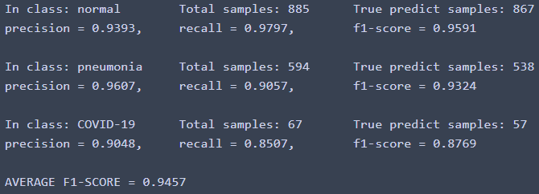
Results
Results of model 1 on validation data.
Results of model 2 on validation data.
Results of model 3 on validation data.
Neural Networks Project
Pagina <number>

Slide 18
Model Comparisons
The best model generated by the experimental procedure has been compared with three other networks to prove its validity:
  A simple convolutional neural network.
  ResNet50 architecture (without applying all the transfer learning methods).
  VGG16 network (without applying all the transfer learning methods).
 | Main model | Simple CNN | Resnet50 w/o TL | Vgg16 w/o TL
F1-score | 0.9457 | 0.8926 | 0.8674 | 0.9263
Time to train (seconds) | 1453 | 304 | 2201 | 2832
Neural Networks Project
Pagina <number>

Slide 19
References
Cortés Aguas, K. (2020) A guide to transfer learning with Keras using ResNet50. Available at: https://medium.com/@kenneth.ca95/a-guide-to-transfer-learning-with-keras-using-resnet50-a81a4a28084b (Last Accessed: 26 March 2021).
COVID-Net original implementation. (2021) Available at: https://github.com/lindawangg/COVID-Net (Last Accessed: 26 March 2021).
Farooq, M. & Hafeez, A. (2020) COVID-ResNet: A Deep Learning Framework for Screening of COVID19 from Radiographs. Available at: https://arxiv.org/ftp/arxiv/papers/2003/2003.14395.pdf (Last Accessed: 26 March 2021).
He, K. & Zhang, X. & Ren, S. & Sun, J. (2015) Deep Residual Learning for Image Recognition. Available at: http://arxiv.org/abs/1512.03385 (Last Accessed: 26 March 2021).
Sachan, A. (2019) Detailed Guide to Understand and Implement ResNets. Available at: https://cv-tricks.com/keras/understand-implement-resnets/ (Last Accessed: 26 March 2021).
Tensorflow Core. (2021) Transfer learning and fine-tuning. Available at: https://www.tensorflow.org/tutorials/images/transfer_learning (Last Accessed: 26 March 2021).
Uncini, A. (2020) Neural Networks Course Material: Convolutional Neural Networks. Available at: http://www.uncini.com/dida/nn/nn_2020/ (Last Accessed: 26 March 2021).
Uncini, A. (2020) Neural Networks Course Material: Convolutional Neural Networks lessons. Available at: https://youtu.be/4mZ0a9XbldA and https://youtu.be/rNHWq3dwhE0 (Last Accessed: 26 March 2021).
Wang, L. & Zhong Qiu, L. & Wong, A. (2020) COVID-Net: A Tailored Deep Convolutional Neural Network Design for Detection of COVID19 Cases from Chest Radiography. Available at: https://arxiv.org/pdf/2003.09871.pdf (Last Accessed: 26 March 2021).
Neural Networks Project
Pagina <number>

